Slide 1


Collections
Design & Content copywrite ©
MKJ IT Solutions New Delhi, India

Slide 2
hashCode() & equals() contract
Condition | Required | Not Required (But Allowed)
x.equals( y ) == true | Go for Hashcode test
x.hashCode( ) == y.hasshCode( ) |  | x.equals( y) is always true
x.equals( y ) == false |  | No Hashcode test requirement
x.hashCode( ) != y.hasshCode( ) | x.equals( y ) == false

Slide 3
The hashCode( ) Contract
Whenever the hashcode method is invoked on the same object once during the execution of same application , the hashcode method must return the same value.
If the Two objects are equals according to equals( ) method, then calling of hashcode( ) on both object must produce the same integer result.
Its NOT required that if equals ( ) method return false then the hashcode must always return the different integer result , because it may possible that in such case hashcode may return same integer number.

Slide 4
The Different Collections and Their Features
List Type ArrayList
Use for fast iteration and fast random access
Its an ordered Collection
Its not sorted .
And not good for the scenarios where we majorly deal with insertion and deletion

Slide 5
List Type Vector
Vector is the legacy collection.(along with HashTable)
Same as ArrayList but its methods are synchronized
Use when performance does not play major role and thread safety is the major concern.

Slide 6
List Type LinkedList
LinkedList is the ordered Collection
Elements are doubly linked to each others.
So that’s why it also supports two new methods , remove from beginning or end.
Its not sorted .
And not good for the scenarios where we majorly deal with iteration and random access of data .
Its good for Insertion and Deletion.

Slide 7
Set Type HashSet
Its Unsorted and Unordered Collection.
It arrange the elements on the basis of hashcode( ).
Use when we want no duplicate and order of insertion does not play any role.

Slide 8
Set Type LinkedHashSet
Its an ordered version of HashSet.
Its not sorted .
It maintains doubly linked list across all elements.
Use this when we care about order of insertion
And majorly deal with insertion and deletion process instead of iteration.

Slide 9
Navigable
NavigableSet
Set Type TreeSet
Its a sorted Collection in ascending order.
It used red-black tree Structure.
The Collection object must implements the comparable or comparator interface

Slide 10
Map Type HashMap
Its an unordered & unsorted Collection
Key value of map is stored on the basis of hashcode( )
Hashmap allows us one null key and multiple null values.

Slide 11
Map type Hashtable
It’s a synchronized form of HashMap.
Hashtable does not allow any null value or key in its structure
Its not sorted .
And not good for the scenarios where we mostly we majorly deal with insertion and deletion
Notes:
Hashtable does not let u have anything null.

Slide 12
Map type LinkedHashMap
Its an ordered Collection.
It is found slower than HashMap in case of Insertion and deletion.
But it is good for fast iteration over HashMap

Slide 13
Navigable
NavigableMap
Map type TreeMap
Its a sorted Map in ascending order.
The Collection object must implements the comparable or comparator interface

Slide 14
Sorted Collection
Introduced in Java 1.6
Navigable
NavigableSet
NavigableMap
TreeSet
TreeMap

Slide 15
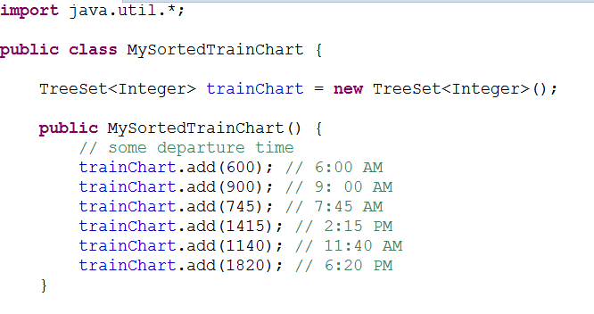

Slide 16
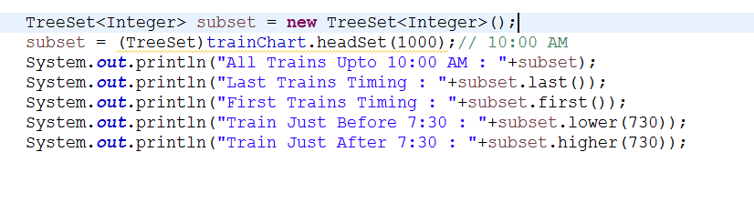


Slide 17
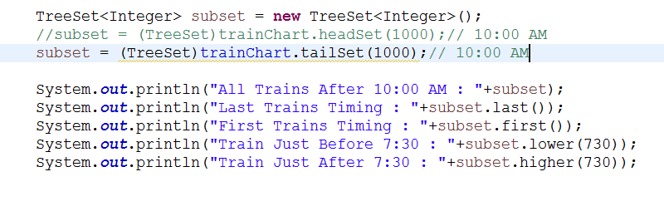


Slide 18
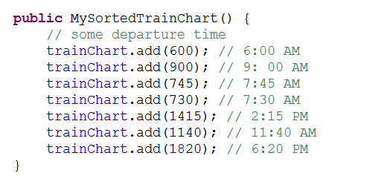
Some more Methods floor( ) & Ceiling( )
New Add

Slide 19
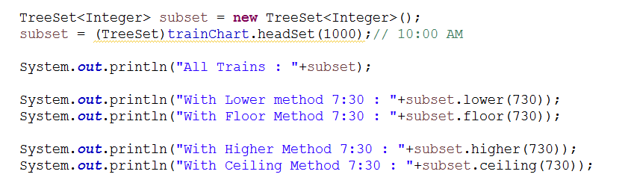

Less than (exclusive)
Less Than & Equal to (inclusive)
Greater Than
(exclusive)
Greater Than & Equal to (inclusive)

Slide 20
MKJ IT Solution Specialization
Advertisement
Java and Java Related All Technologies.
PHP
Android & IOS
Oracle , SQL Server
CISCO
PMP Certifications

